Slide 1




SAP Sales Data, Live in Snowflake
Oracle → Debezium → Kafka → Snowflake → customer portal and AI assistant. A step-by-step setup guide.
Project folder: D:\Anthropic\claude-code-in-one-shot\oracle-snowflake-cdc
Notes:
This guide walks through the whole pipeline we built: SAP Sales & Distribution tables in Oracle, change data capture with Debezium into Kafka, the Snowflake Kafka connector v4 into a raw layer, curated and Gold layers in Snowflake, a Cortex Agent, and a customer portal with an AI assistant. Each step slide shows where to run it, the exact commands, and what you should see.

Slide 2


What you will build
ARCHITECTURE
Oracle
Debezium
Kafka
Snowflake connector
Bronze → Silver → Gold
Portal + AI
30 SAP SD tables
(schema SAPSD)
Reads the redo log
(LogMiner)
One topic per table
sap.SAPSD.*
Kafka connector v4
Snowpipe Streaming
Raw JSON → typed
→ business tables
Order portal and
Cortex Agent chat
~5 s
5–10 s
1 min
1 min
commit → Kafka
Kafka → raw table
MERGE task → Silver
dynamic table → Gold
Result: an order saved in Oracle shows up in the portal in about 2–3 minutes.
Notes:
Left to right: SAP tables live in an Oracle Free container. Debezium reads Oracle's redo log and publishes every insert, update and delete to Kafka, one topic per table. The Snowflake Connector for Kafka v4 streams those events into raw VARIANT tables. Streams and MERGE tasks build typed Silver tables, dynamic tables build Gold, and the portal and AI assistant read Gold.

Slide 3



Three rules the pipeline enforces
DESIGN PRINCIPLES
Never count an order twice
Every step is safe to retry
Deleted data can be recovered
Events ordered by Oracle SCN, then Kafka offset
MERGE ignores older or replayed events
Cancellations and credit memos subtract revenue
Connector v4 delivers exactly once
Streams only advance when a MERGE commits
Re-running scripts and SQL changes nothing twice
Bronze keeps every CDC event, forever
Deletes are soft (CDC_IS_DELETED = TRUE)
Silver and Gold can be rebuilt by replay
Notes:
These are the three rules from the original plan. Every design choice maps to one of them. The best test: the sample data contains an invoice that was cancelled and re-billed. Summing invoices naively gives INR 1,05,02,225; the pipeline correctly reports INR 1,03,88,950.

Slide 4
Three layers in Snowflake
MEDALLION ARCHITECTURE
BRONZE
SAP_RAW.SD
Every CDC event exactly as received, as JSON (VARIANT). Append-only audit trail and replay source.
Loaded by
Kafka connector v4
SILVER
SAP_CURATED.SD
One typed row per primary key, same columns and types as Oracle, plus CDC columns. Soft deletes.
Loaded by
Streams + MERGE tasks (1 min)
GOLD
SAP_GOLD.SALES
Business tables: SALES_DOC_HDR, SALES_DOC_POS, DEL_DOC_POS. Business names, statuses, KPIs.
Loaded by
Dynamic tables (1 min lag)
Notes:
Data only moves upward: Gold reads Silver, Silver reads Bronze. Each layer can be rebuilt from the one below. Business rules such as signed revenue live in Gold; Silver stays a faithful copy of SAP.

Slide 5

Before you start
PREREQUISITES
Docker Desktop with 8 GB memory for containers
Folder | What is inside
oracle/ | SAP table DDL, sample data, Debezium user
connect/ | Kafka Connect image (Debezium + Snowflake v4)
connectors/ | Source and sink connector configs
scripts/ | Setup, status, daily orders, generators
snowflake/ | Setup, curated, Gold, agent, portal SQL
portal/ | Customer portal (FastAPI + web page)
Snowflake account with an ACCOUNTADMIN user (a trial works)
Git for Windows: Git Bash runs the scripts/*.sh files
Python 3.12 (python.org, tick “Add python.exe to PATH”)
Free ports: 1522 Oracle, 8083 Connect, 8085 Kafka UI, 8010 portal
Notes:
Ports are the ones we ended up with on your PC: Oracle moved to 1522 and Kafka UI to 8085 because 1521 and 8080 were taken by a local Oracle installation. The portal runs on 8010 because 8000 was busy.

Slide 6
Setup roadmap: ten steps
ROADMAP
1
2
3
4
5
Snowflake account setup
Start the Docker stack
Prepare Oracle, load SAP data
Start Debezium to Kafka
Start Snowflake sink
Git Bash + Snowsight
PowerShell
Git Bash
Git Bash
Git Bash + Snowsight
6
7
8
9
10
Build Silver (curated)
Build Gold tables
Create the sales agent
Run the customer portal
Turn on the AI assistant
Snowsight
Snowsight
Snowsight
PowerShell
Snowsight + browser
Notes:
Steps 1 to 5 build the streaming path from Oracle to Snowflake. Steps 6 to 8 build the Snowflake layers and the agent. Steps 9 and 10 bring up the portal and its AI assistant. Each step is safe to re-run.

Slide 7
Snowflake account setup
STEP 1 OF 10 · GIT BASH + SNOWSIGHT
Generate the connector's key pair
Run the rendered setup SQL as ACCOUNTADMIN
Copy snowflake_url_name into .env as SNOWFLAKE_URL
You should see
RSA_PUBLIC_KEY_FP in DESC USER equals the printed fingerprint
Databases SAP_RAW and SAP_CURATED exist
Last query returns your account URL
Git Bash · snowflake folder
cd snowflake
bash generate_snowflake_keys.sh
Snowsight · Projects » Workspaces
-- upload snowflake_setup_rendered.sql
GRANT ROLE SAP_TRANSFORM_ROLE TO USER <you>;
-- Ctrl + Shift + Enter runs the whole file
Creates KAFKA_CONNECTOR_USER (key-pair only), the connector and transform roles, and an XS warehouse.
Notes:
Step 1: Snowflake account setup. Where: git bash + snowsight. Generate the connector's key pair. Run the rendered setup SQL as ACCOUNTADMIN. Copy snowflake_url_name into .env as SNOWFLAKE_URL. Expected: RSA_PUBLIC_KEY_FP in DESC USER equals the printed fingerprint; Databases SAP_RAW and SAP_CURATED exist; Last query returns your account URL. Creates KAFKA_CONNECTOR_USER (key-pair only), the connector and transform roles, and an XS warehouse.

Slide 8
Start the Docker stack
STEP 2 OF 10 · POWERSHELL · PROJECT FOLDER
Create .env from the example and set SNOWFLAKE_URL
Build and start Oracle, Kafka, Kafka Connect, Kafka UI
Wait until three containers are healthy
You should see
oracle, kafka, connect show (healthy)
Oracle reachable on localhost:1522
Kafka UI on http://localhost:8085
PowerShell
copy .env.example .env
notepad .env
docker compose up -d --build
docker compose ps
First start downloads about 4 GB of images and takes 5–15 minutes.
Notes:
Step 2: Start the Docker stack. Where: powershell · project folder. Create .env from the example and set SNOWFLAKE_URL. Build and start Oracle, Kafka, Kafka Connect, Kafka UI. Wait until three containers are healthy. Expected: oracle, kafka, connect show (healthy); Oracle reachable on localhost:1522; Kafka UI on http://localhost:8085. First start downloads about 4 GB of images and takes 5–15 minutes.

Slide 9
Prepare Oracle and load SAP data
STEP 3 OF 10 · GIT BASH · PROJECT FOLDER
Turn on ARCHIVELOG mode and supplemental logging
Create the Debezium user c##dbzuser
Create 30 SAP SD tables and load sample data
You should see
Row counts printed: VBAK 27, VBAP 61, LIKP 21, VBRK 22
Last line: “Oracle is ready for Debezium.”
Safe to re-run: data is cleared and reloaded
Git Bash
./scripts/01_oracle_setup.sh
Oracle restarts once inside the container while ARCHIVELOG is switched on. That is expected.
Notes:
Step 3: Prepare Oracle and load SAP data. Where: git bash · project folder. Turn on ARCHIVELOG mode and supplemental logging. Create the Debezium user c##dbzuser. Create 30 SAP SD tables and load sample data. Expected: Row counts printed: VBAK 27, VBAP 61, LIKP 21, VBRK 22; Last line: “Oracle is ready for Debezium.”; Safe to re-run: data is cleared and reloaded. Oracle restarts once inside the container while ARCHIVELOG is switched on. That is expected.

Slide 10
Start Debezium: Oracle to Kafka
STEP 4 OF 10 · GIT BASH · PROJECT FOLDER
Register the Debezium Oracle source connector
It snapshots all 30 tables, then streams changes
Check the connector and the topics
You should see
sap-sd-oracle-source: RUNNING (connector and task)
30 topics named sap.SAPSD.<TABLE>
Events show before, after, op and source.scn
Git Bash
./scripts/02_register_connectors.sh source
./scripts/status.sh
Snapshot rows have op = r; live changes use c (insert), u (update) and d (delete).
Notes:
Step 4: Start Debezium: Oracle to Kafka. Where: git bash · project folder. Register the Debezium Oracle source connector. It snapshots all 30 tables, then streams changes. Check the connector and the topics. Expected: sap-sd-oracle-source: RUNNING (connector and task); 30 topics named sap.SAPSD.<TABLE>; Events show before, after, op and source.scn. Snapshot rows have op = r; live changes use c (insert), u (update) and d (delete).

Slide 11
Start the Snowflake sink: Kafka to Bronze
STEP 5 OF 10 · GIT BASH + SNOWSIGHT
Register the Snowflake Kafka connector v4
It creates one *_RAW table per topic in SAP_RAW.SD
Check the raw tables in Snowflake
You should see
sap-sd-snowflake-sink: RUNNING
30 *_RAW tables with RECORD_CONTENT and RECORD_METADATA
VBAK_RAW returns 27 rows
Git Bash
./scripts/02_register_connectors.sh sink
Snowsight
SHOW TABLES IN SCHEMA SAP_RAW.SD;
SELECT COUNT(*) FROM SAP_RAW.SD.VBAK_RAW;
Billed per GB ingested; no warehouse is used for loading.
Notes:
Step 5: Start the Snowflake sink: Kafka to Bronze. Where: git bash + snowsight. Register the Snowflake Kafka connector v4. It creates one *_RAW table per topic in SAP_RAW.SD. Check the raw tables in Snowflake. Expected: sap-sd-snowflake-sink: RUNNING; 30 *_RAW tables with RECORD_CONTENT and RECORD_METADATA; VBAK_RAW returns 27 rows. Billed per GB ingested; no warehouse is used for loading.

Slide 12
Build Silver: curated typed tables
STEP 6 OF 10 · SNOWSIGHT
Run the curated layer script once
It creates a typed table, stream and MERGE task per SAP table
Tasks start and load the snapshot immediately
You should see
30 tables in SAP_CURATED.SD with real column types
Live row counts match Oracle
Section E: no FAILED task runs
Snowsight · run the whole file
snowflake/04_curated_layer.sql
Check
SELECT "VBELN", "NETWR", "ERDAT"
FROM SAP_CURATED.SD.VBAK
WHERE NOT CDC_IS_DELETED;
Latest event per key wins (SCN, then offset). Deletes become CDC_IS_DELETED = TRUE.
Notes:
Step 6: Build Silver: curated typed tables. Where: snowsight. Run the curated layer script once. It creates a typed table, stream and MERGE task per SAP table. Tasks start and load the snapshot immediately. Expected: 30 tables in SAP_CURATED.SD with real column types; Live row counts match Oracle; Section E: no FAILED task runs. Latest event per key wins (SCN, then offset). Deletes become CDC_IS_DELETED = TRUE.

Slide 13
Build Gold: business tables
STEP 7 OF 10 · SNOWSIGHT
Run the Gold script once
Creates three dynamic tables with a 1-minute lag
Check a known figure from the sample data
You should see
SALES_DOC_HDR: 27 documents
SALES_DOC_POS: 61 items, DEL_DOC_POS: 49 delivery items
Billed revenue INR 1,03,88,950 (cancellation netted out)
Snowsight · run the whole file
snowflake/07_gold_sales.sql
Check
SELECT SUM(NET_BILLED_VALUE)
FROM SAP_GOLD.SALES.SALES_DOC_POS;
Figures are for the original sample data and grow as daily orders arrive.
Notes:
Step 7: Build Gold: business tables. Where: snowsight. Run the Gold script once. Creates three dynamic tables with a 1-minute lag. Check a known figure from the sample data. Expected: SALES_DOC_HDR: 27 documents; SALES_DOC_POS: 61 items, DEL_DOC_POS: 49 delivery items; Billed revenue INR 1,03,88,950 (cancellation netted out). Figures are for the original sample data and grow as daily orders arrive.

Slide 14
Create the sales agent
STEP 8 OF 10 · SNOWSIGHT
Run the agent script as ACCOUNTADMIN + SAP_TRANSFORM_ROLE
Creates semantic view SV_SAP_SALES and agent SAP_SALES_AGENT
Ask it questions in AI & ML » Agents
You should see
“What is our total billed revenue?” → INR 1,03,88,950
“Which orders are blocked for credit?” → 10022
Each answer shows the SQL it ran
Snowsight · run the whole file
snowflake/05_sales_agent.sql
If Cortex is not in your region
ALTER ACCOUNT SET
CORTEX_ENABLED_CROSS_REGION = 'ANY_REGION';
The semantic view holds synonyms, 20 metrics and the SAP revenue rules.
Notes:
Step 8: Create the sales agent. Where: snowsight. Run the agent script as ACCOUNTADMIN + SAP_TRANSFORM_ROLE. Creates semantic view SV_SAP_SALES and agent SAP_SALES_AGENT. Ask it questions in AI & ML » Agents. Expected: “What is our total billed revenue?” → INR 1,03,88,950; “Which orders are blocked for credit?” → 10022; Each answer shows the SQL it ran. The semantic view holds synonyms, 20 metrics and the SAP revenue rules.

Slide 15
Run the customer portal
STEP 9 OF 10 · POWERSHELL · PROJECT FOLDER
Create the portal key and run 06_portal_access.sql
Fill in portal\.env: account, user, key, SAPSD_PASSWORD
Install packages and start the web server
You should see
http://127.0.0.1:8010 opens the portal
Footer: “Data as of … · role SAP_PORTAL_ROLE”
/api/health shows oracle_orders_enabled: true
PowerShell
python -m venv .venv
.\.venv\Scripts\Activate.ps1
python -m pip install -r portal\requirements.txt
python scripts\make_key.py portal_key
python -m uvicorn portal.app:app --reload --port 8010
SNOWFLAKE_ACCOUNT format: your org-account identifier, with no < > or quotes.
Notes:
Step 9: Run the customer portal. Where: powershell · project folder. Create the portal key and run 06_portal_access.sql. Fill in portal\.env: account, user, key, SAPSD_PASSWORD. Install packages and start the web server. Expected: http://127.0.0.1:8010 opens the portal; Footer: “Data as of … · role SAP_PORTAL_ROLE”; /api/health shows oracle_orders_enabled: true. SNOWFLAKE_ACCOUNT format: your org-account identifier, with no < > or quotes.

Slide 16
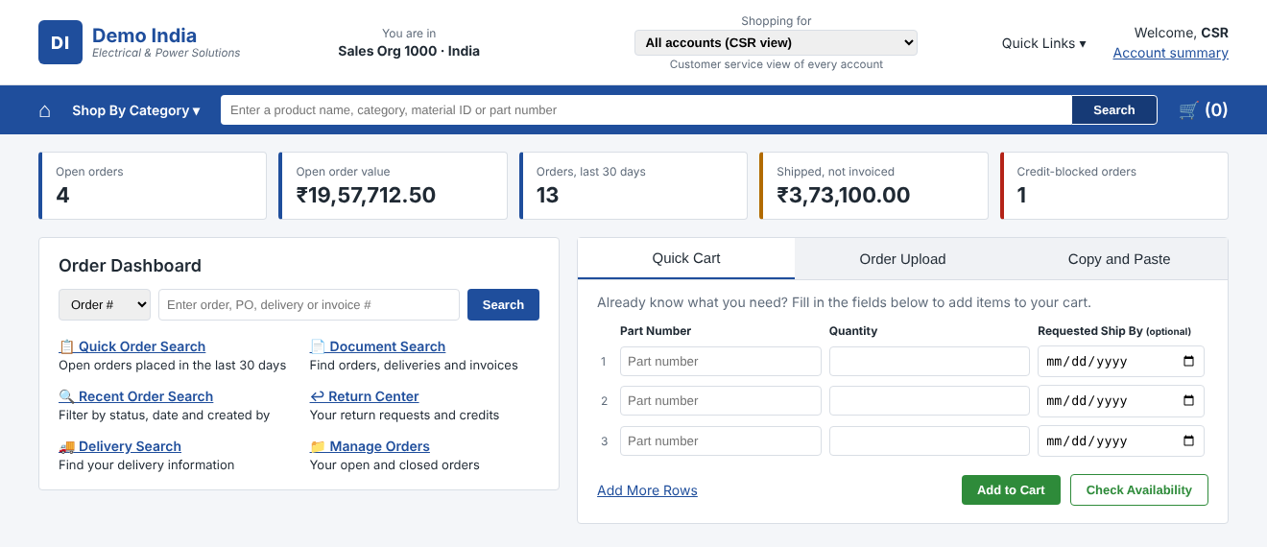
The customer portal
STEP 9 · WHAT YOU GET
Shopping for
pick a customer; every screen filters to it
Order Dashboard
search by order, PO, delivery or invoice number
Order and delivery views
quick, recent, open and closed orders; deliveries; documents; returns
Quick Cart
type, upload CSV or paste lines, then Check Availability
Place Order
writes to Oracle and returns through CDC in ~2–3 min
Home page: account selector, live KPI tiles from Gold, Order Dashboard search and Quick Cart.
Notes:
Every screen is one read-only, parameterised query on SAP_GOLD.SALES. Check Availability estimates ship dates from shipping history because the model has no stock table. Place Order writes a real SAP-style order into Oracle; the confirmation page tells you when it has arrived in Snowflake.

Slide 17
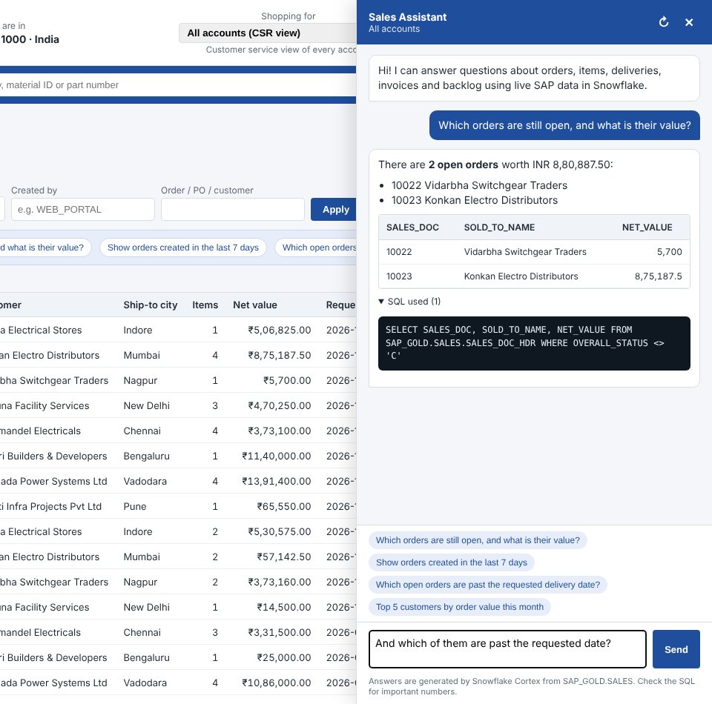
Turn on the AI assistant
STEP 10 OF 10 · SNOWSIGHT + BROWSER
Run the “AI assistant” section of 06_portal_access.sql
Restart the portal and press Ctrl + Shift + R
Click ✨ Ask AI on any page, or a suggested question on Recent Orders
Snowsight · ACCOUNTADMIN
GRANT DATABASE ROLE SNOWFLAKE.CORTEX_AGENT_USER
TO ROLE SAP_PORTAL_ROLE;
GRANT USAGE ON AGENT
SAP_GOLD.SALES.SAP_SALES_AGENT TO ROLE SAP_PORTAL_ROLE;
Follows the customer selector · keeps the conversation · shows the result table and the SQL it ran
Notes:
The portal sends the question, the selected customer and the conversation so far to the Cortex Agent through the Cortex Agents REST API, using the portal's Snowflake session. Error 403 means the grants are missing; 404 means the agent does not exist yet.

Slide 18




Run it every day
OPERATIONS
New orders
Schedule it
Check freshness
If data is stale
python scripts\daily_orders.py
Task Scheduler runs
/api/health → DATA_AS_OF
docker compose ps · ./scripts/status.sh
10 orders, 50 items by default
scripts\run_daily_orders.bat at 09:00
should be minutes old, not days
SHOW TASKS IN SCHEMA SAP_CURATED.SD
Before a demo: start Docker Desktop, check the connectors are RUNNING and the tasks started, then place one order in the portal and watch it arrive.
Notes:
When you last checked, DATA_AS_OF was 19 October: nothing new had reached Snowflake for three days. That means either the Docker stack was stopped or the curated tasks were suspended. Check those three things before anything else.

Slide 19
Verify the pipeline end to end
ACCEPTANCE CHECKS
Check | How | Expected
Exactly once | snowflake/03_checks.sql, check 1 | raw events = distinct events, every table
Counts match | Oracle 91_row_counts.sql vs Silver | same live row count per table
No double counting | SUM(NET_BILLED_VALUE) in Gold | INR 1,03,88,950 on sample data
Changes flow | ./scripts/03_make_changes.sh | credit release, new order, delete visible in ~2 min
Portal round trip | Place Order in the portal | “Arrived in Snowflake Gold after N seconds”
Recovery | 04_curated_layer.sql, section F | truncate + replay rebuilds identical rows
Notes:
These checks prove the three rules: exactly-once loading, no double counting, and recovery by replay. Run them after setup and again after any change to the SQL.

Slide 20
Troubleshooting: problems we already hit
FIXES
Symptom | Fix
Port is already allocated (1521, 8080, 8000) | Change the left port in docker-compose.yml (1522, 8085) or use --port 8010
docker: input/output error while building | docker builder prune -af, wsl --shutdown, restart Docker Desktop
Git Bash: Could not fork child process | Restart Windows; or run Docker commands from PowerShell
pip / py is not recognized | Install Python 3.12 with “Add to PATH”, then python -m pip
Invalid character '<' in account identifier | Set SNOWFLAKE_ACCOUNT to your real org-account value
Place Order greyed out | Add SAPSD_PASSWORD=sapsd to portal\.env and restart
Ask AI button missing | Copy the new portal files, restart, Ctrl + Shift + R
Notes:
Every row here is something that came up during this setup on your Windows PC. The README's troubleshooting table covers connector and Snowflake task errors as well.

Slide 21
Next steps
Restart the stalled data flow, then extend Gold with order-to-cash KPIs.
Get data flowing again: Docker up, connectors RUNNING, tasks started
Add KPIs to Gold: on-time-in-full, fill rate, open backlog value
Connect a Snowflake workspace to GitHub for version control
For production: Openflow or managed Kafka instead of a laptop stack
Notes:
The most urgent item is the first one: the portal was showing data from 19 October, so the pipeline needs to be restarted before a demo.

